Slide 2
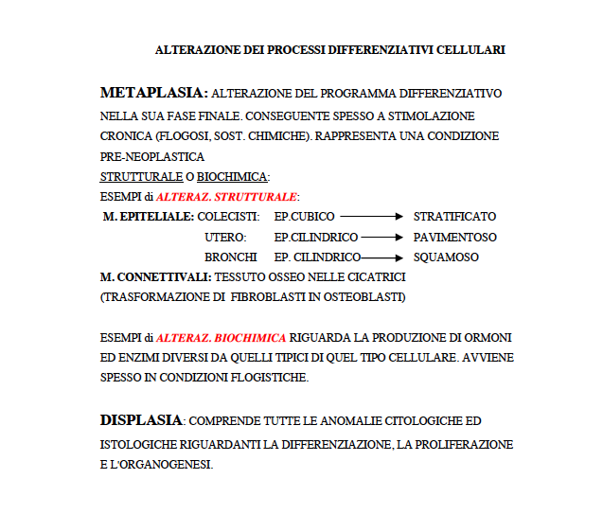
Le neoplasie non sono le sole manifestazioni di alterazione della differenziazione cellulare

Slide 3
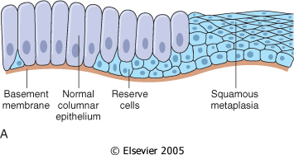
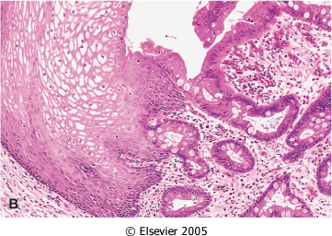
Notes:
Metaplasia. A, Schematic diagram of columnar to squamous metaplasia. B, Metaplastic transformation of esophageal stratified squamous epithelium (left) to mature columnar epithelium (so-called Barrett metaplasia).
Metaplasia from squamous to columnar type may also occur, as in Barrett esophagus, in which the esophageal squamous epithelium is replaced by intestinal-like columnar cells under the influence of refluxed gastric acid (Fig. 1-6B). Cancers may arise in these areas, and these are typically glandular (adeno)carcinomas
Metaplasia is a reversible change in which one adult cell type (epithelial or mesenchymal) is replaced by another adult cell type.¹³ It may represent an adaptive substitution of cells that are sensitive to stress by cell types better able to withstand the adverse environment.
The most common epithelial metaplasia is columnar to squamous (Fig. 1-6A), as occurs in the respiratory tract in response to chronic irritation. In the habitual cigarette smoker, the normal ciliated columnar epithelial cells of the trachea and bronchi are often replaced focally or widely by stratified squamous epithelial cells. Stones in the excretory ducts of the salivary glands, pancreas, or bile ducts may cause replacement of the normal secretory columnar epithelium by nonfunctioning stratified squamous epithelium. A deficiency of vitamin A (retinoic acid) induces squamous metaplasia in the respiratory epithelium, and vitamin A excess suppresses keratinization (Chapter 9). In all these instances, the more rugged stratified squamous epithelium is able to survive under circumstances in which the more fragile specialized columnar epithelium most likely would have succumbed. Although the metaplastic squamous cells in the respiratory tract, for example, are capable of surviving, an important protective mechanism-mucus secretion-is lost. Thus, epithelial metaplasia is a two-edged sword and, in most circumstances, represents an undesirable change. Moreover, the influences that predispose to metaplasia, if persistent, may induce malignant transformation in metaplastic epithelium. Thus, the common form of cancer in the respiratory tract is composed of squamous cells, which arise in areas of metaplasia of the normal columnar epithelium into squamous epithelium.
Mechanisms of Metaplasia. Metaplasia does not result from a change in the phenotype of a differentiated cell type; instead it is the result of a reprogramming of stem cells that are known to exist in normal tissues, or of undifferentiated mesenchymal cells present in connective tissue. In a metaplastic change, these precursor cells differentiate along a new pathway. The differentiation of stem cells to a particular lineage is brought about by signals generated by cytokines, growth factors, and extracellular matrix components in the cell's environment. Tissue-specific and differentiation genes are involved in the process, and an increasing number of these are being identified.¹⁴ For example, bone morphogenetic proteins, members of the TGF-βsuperfamily, induce chondrogenic or osteogenic expression in stem cells while suppressing differentiation into muscle or fat.¹⁵ These growth factors, acting as external triggers, then induce specific transcription factors that lead the cascade of phenotype-specific genes toward a fully differentiated cell. How these normal pathways run amok to cause metaplasia is unclear in most instances. In the case of vitamin A deficiency or excess, it is known that retinoic acid regulates cell growth, differentiation, and tissue patterning and may thus influence the differentiation pathway of stem cells.¹⁶ Certain cytostatic drugs cause a disruption of DNA methylation patterns and can transform mesenchymal cells from one type (fibroblast) to another (muscle, cartilage).

Slide 5
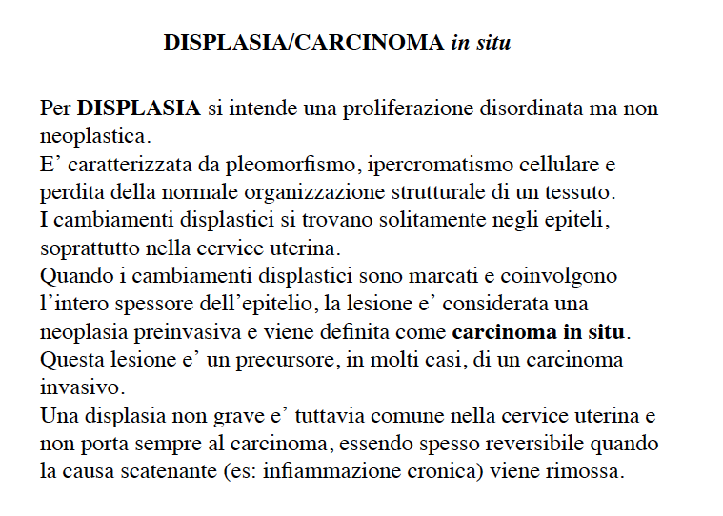

Slide 6
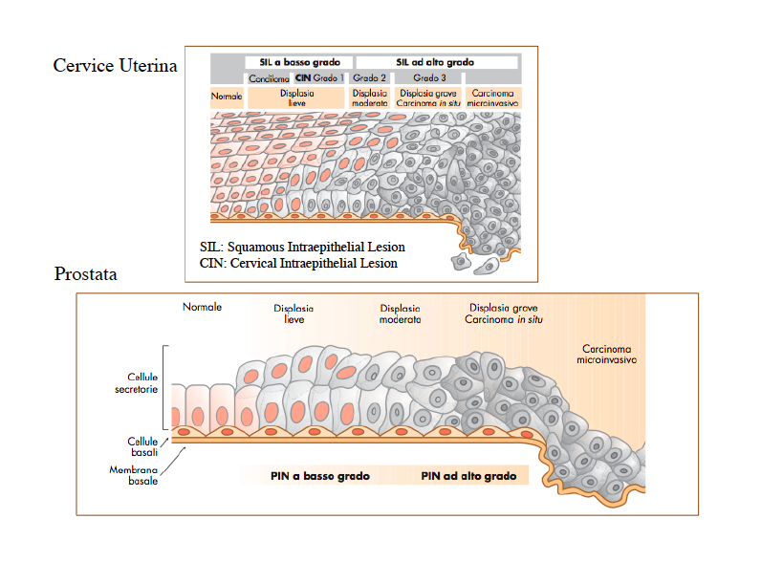

Slide 7
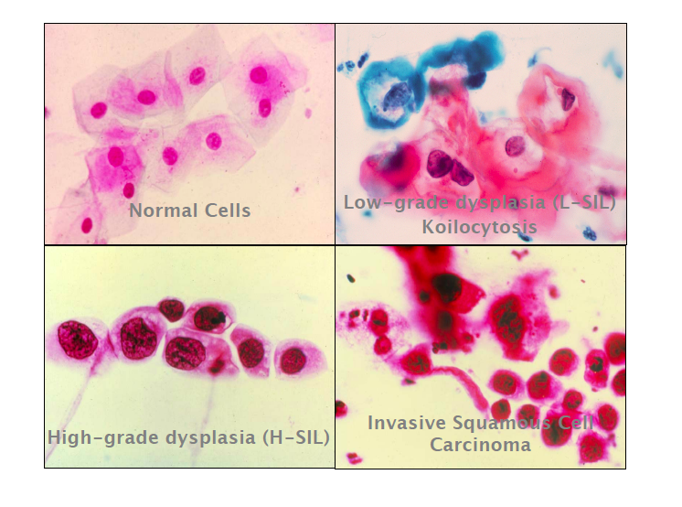

Slide 8
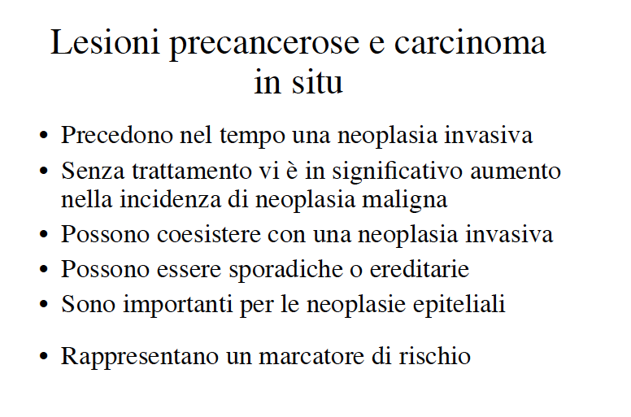

Slide 9
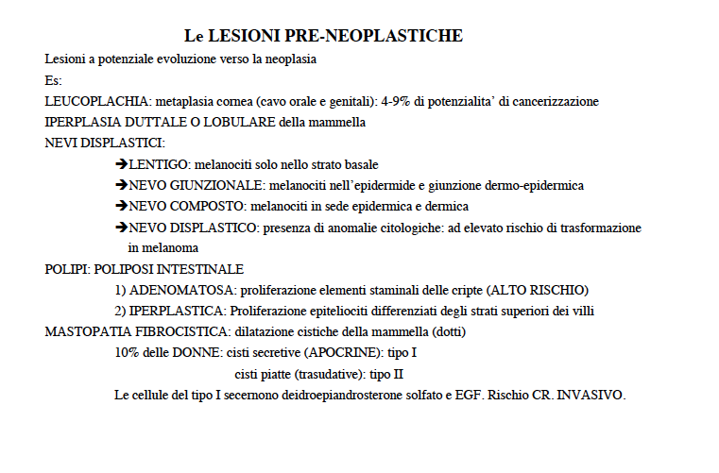

Slide 10
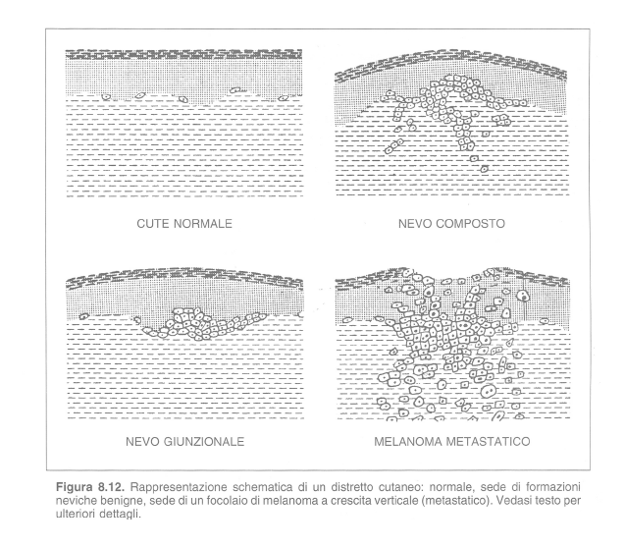

Slide 11
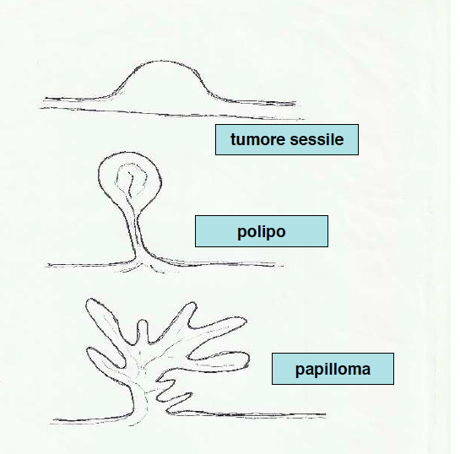

Slide 12
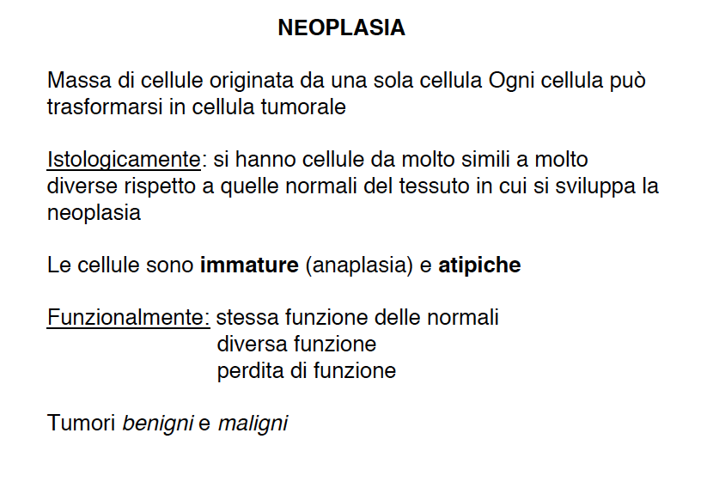

Slide 13
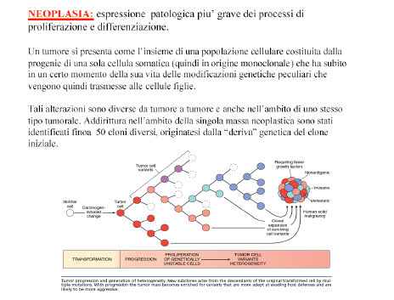

Slide 14
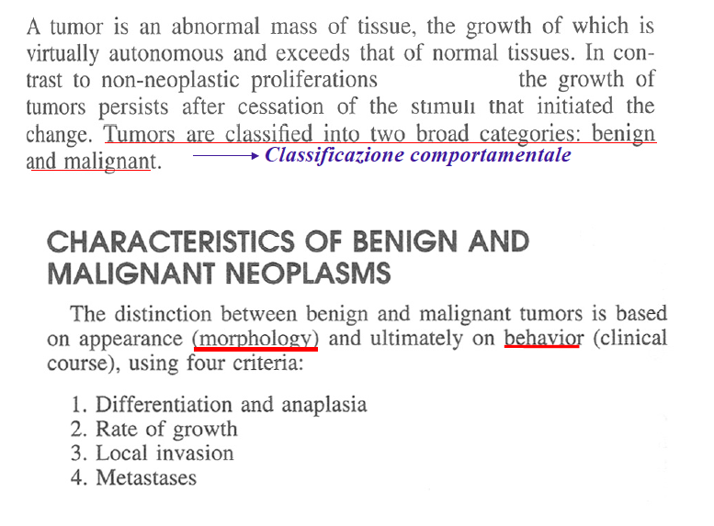

Slide 17
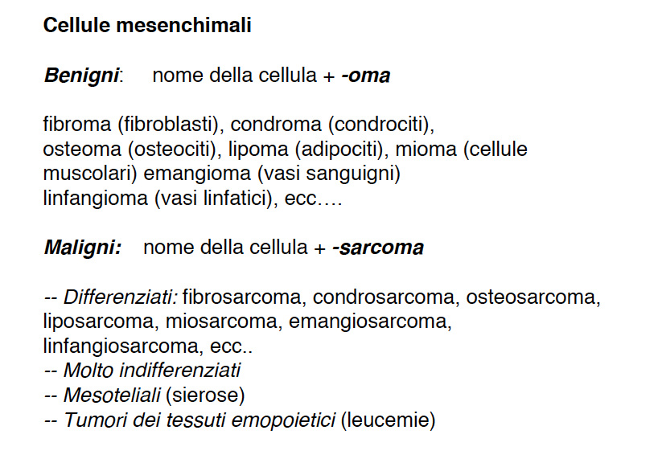

Slide 18
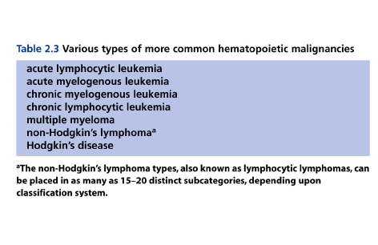

Slide 19
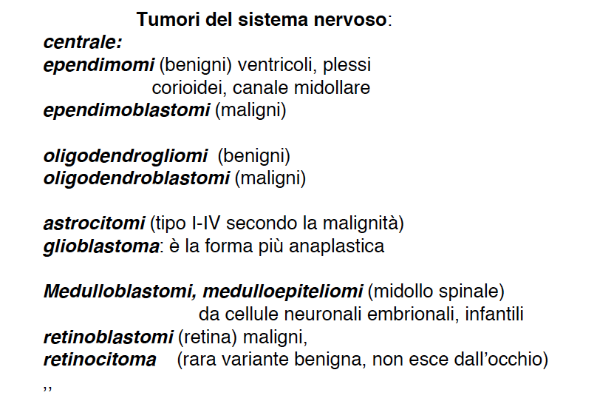

Slide 20
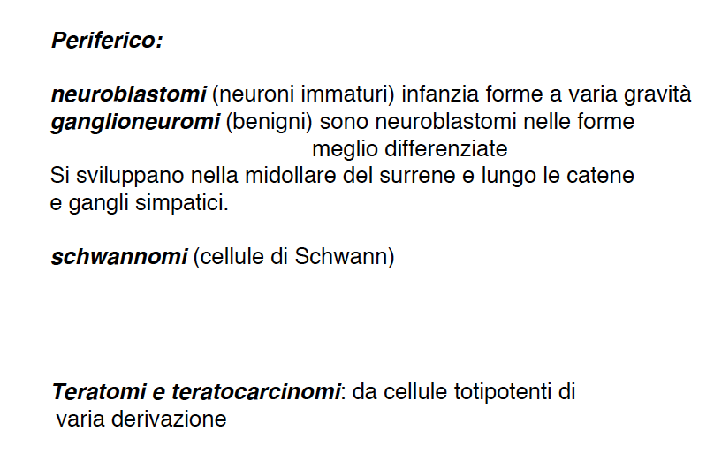

Slide 25
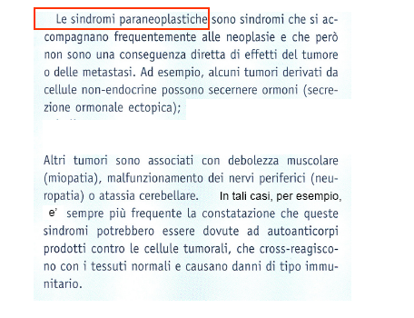

Slide 26
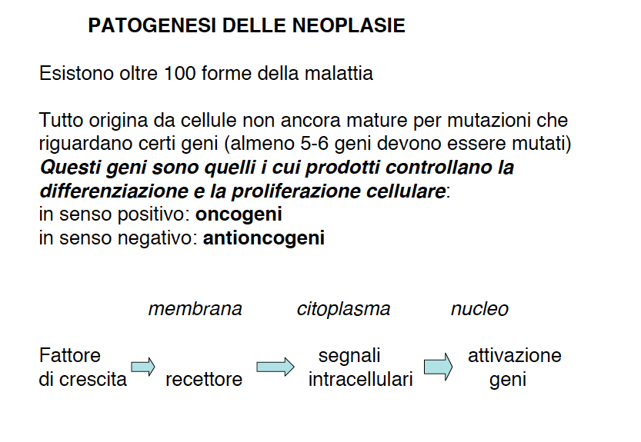

Slide 27
